Slide 1

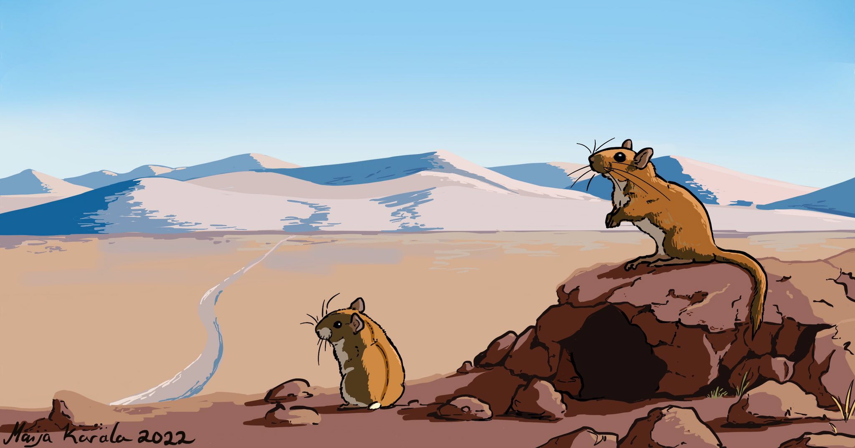
Advancing Energetic Modelling in Wildlife Populations

Slide 2
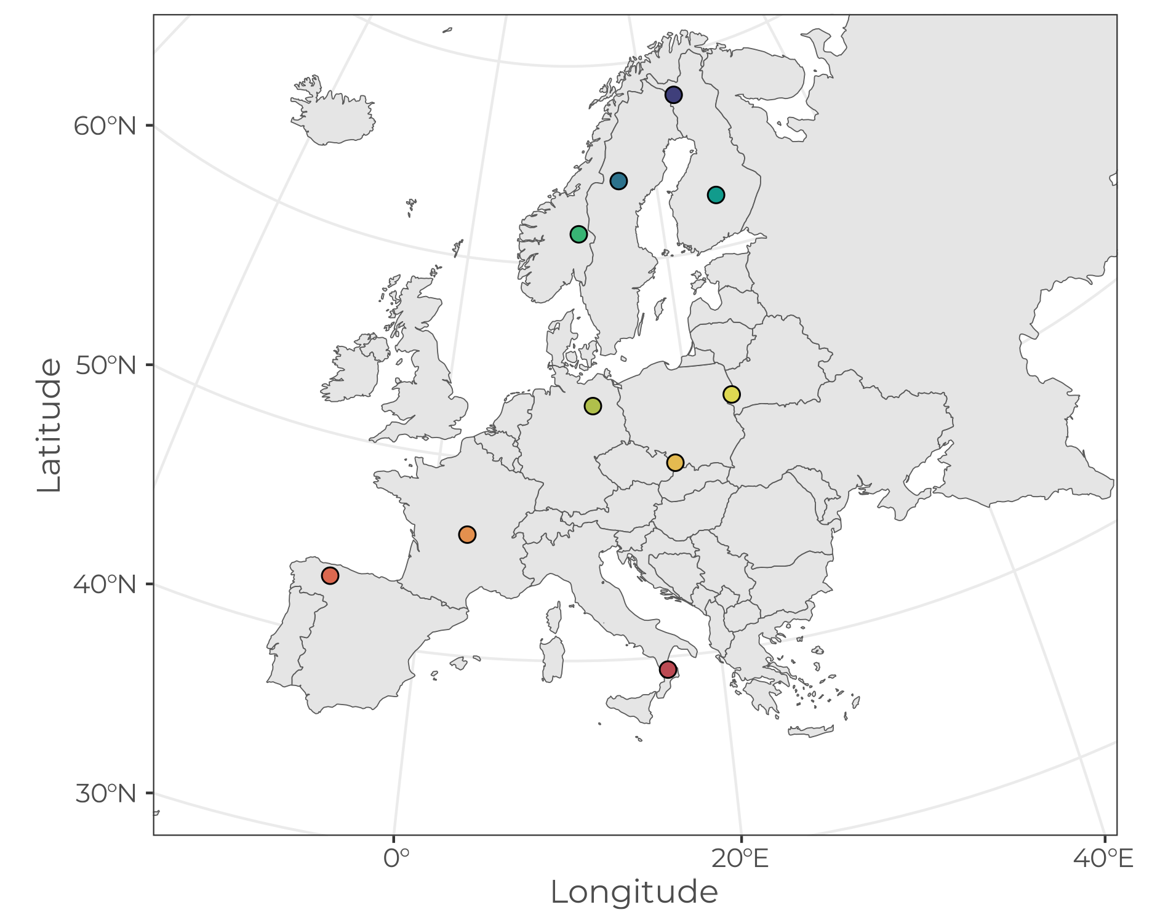
Scenarios

Slide 3
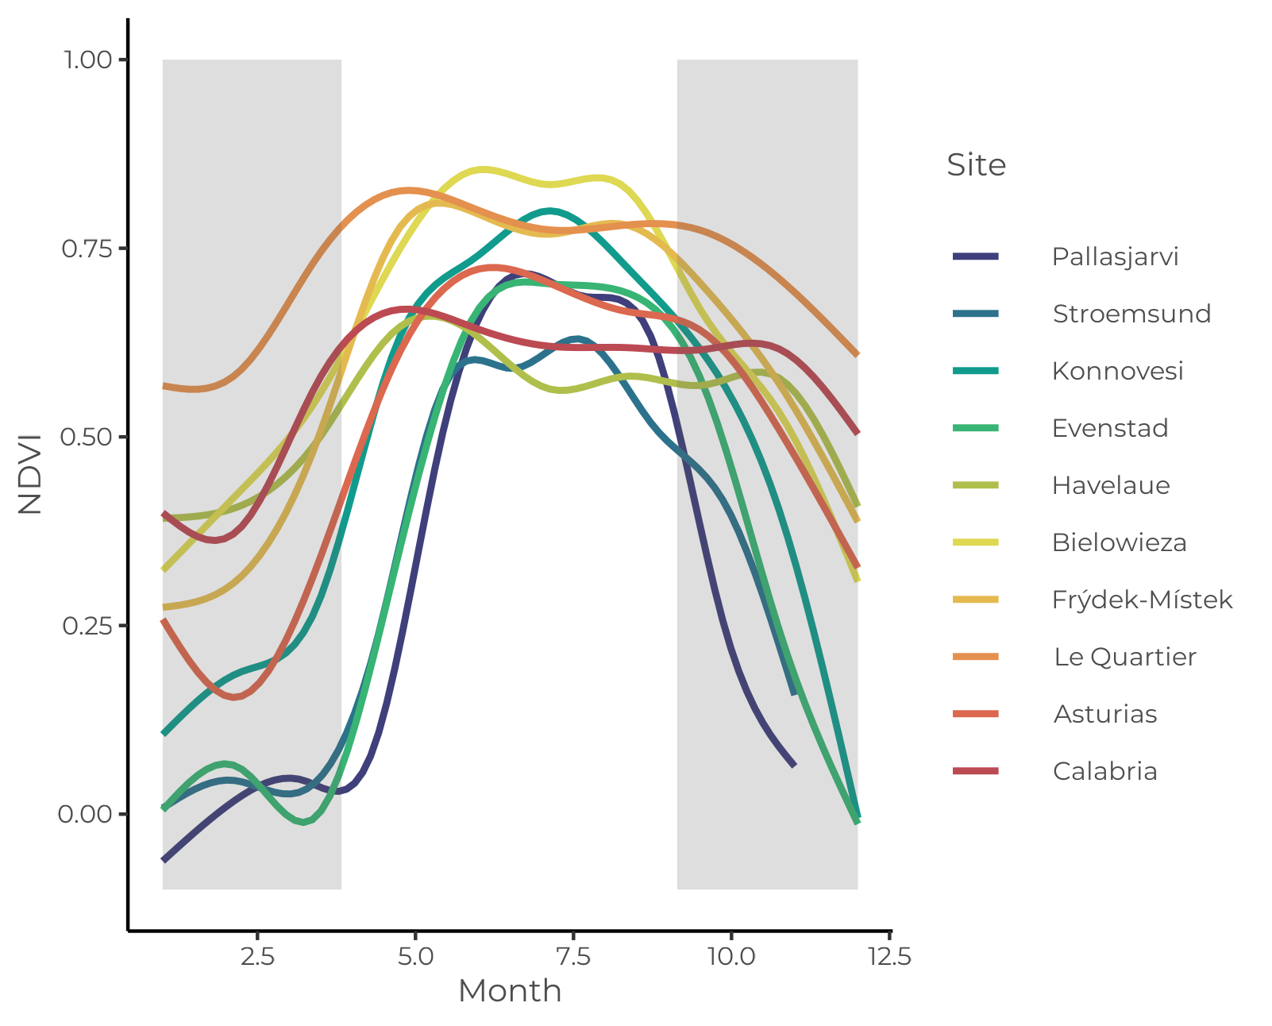
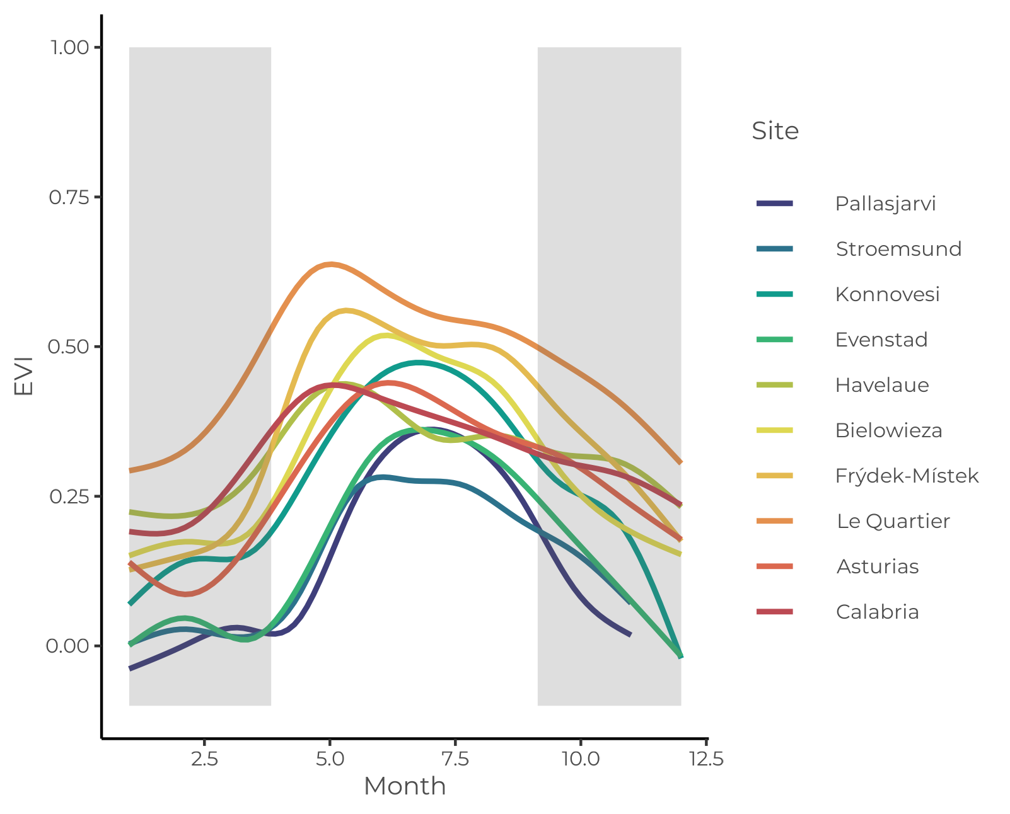
MODIS data
Product: MOD13Q1
Spatial resolution: 250 m
Temporal resolution: 16 days
Date range: 2000-01-01 to 2022-12-30
Variables: NDVI & EVI

Slide 4
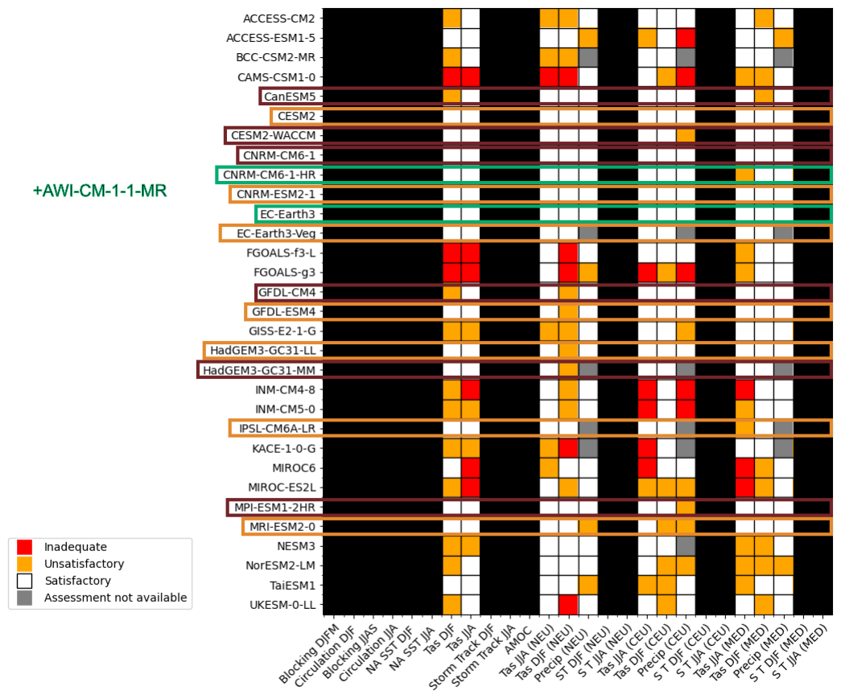
GCM data
Models were selected as those which were found to have:
A maximum of 1 unsatisfactory finding for performance for temperature and precipitation outputs
High resolution land cover
Available outputs for all combinations of variables, experiments, dates, etc.
Palmer et al. 2023 10.5194/esd-14-457-2023

Slide 5

GCM data
Models: CNRM-CM6-1-HR,
EC-Earth3-CC,
AWI-CM-1-1-MR
Spatial resolution: 0.50°, 0.70°, & 0.94°
Temporal resolution: Monthly
Experiments: Historical, ssp245, & ssp585
Date range: 2000 - 2014 & 2015 - 2100
Variables: pr (Precipitation),
tasmin (Daily Minimum Near-Surface Air Temperature),
rsdt (TOA Incident Shortwave Radiation)
+

Slide 6
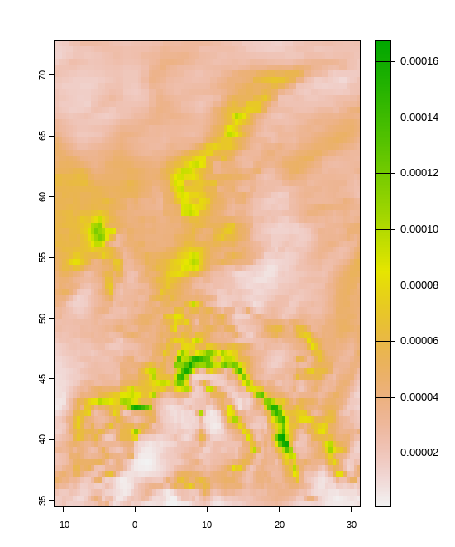
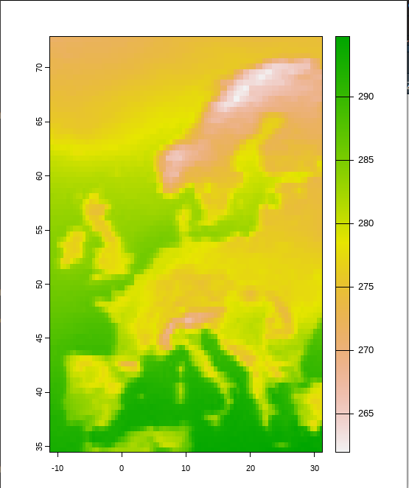
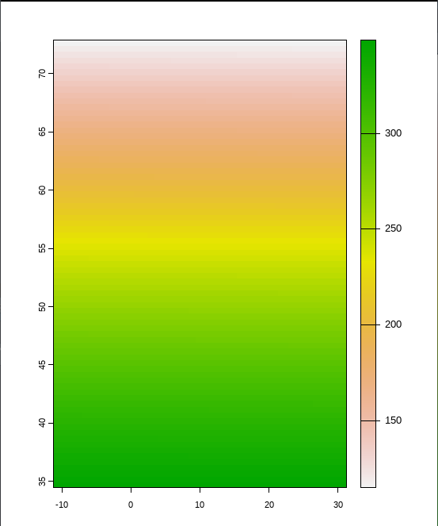
GCM data
TOA Incident Shortwave Radiation
(rsdt)
Daily Minimum Near-Surface Air Temperature
(tasmin)
Precipitation
(pr)

Slide 7
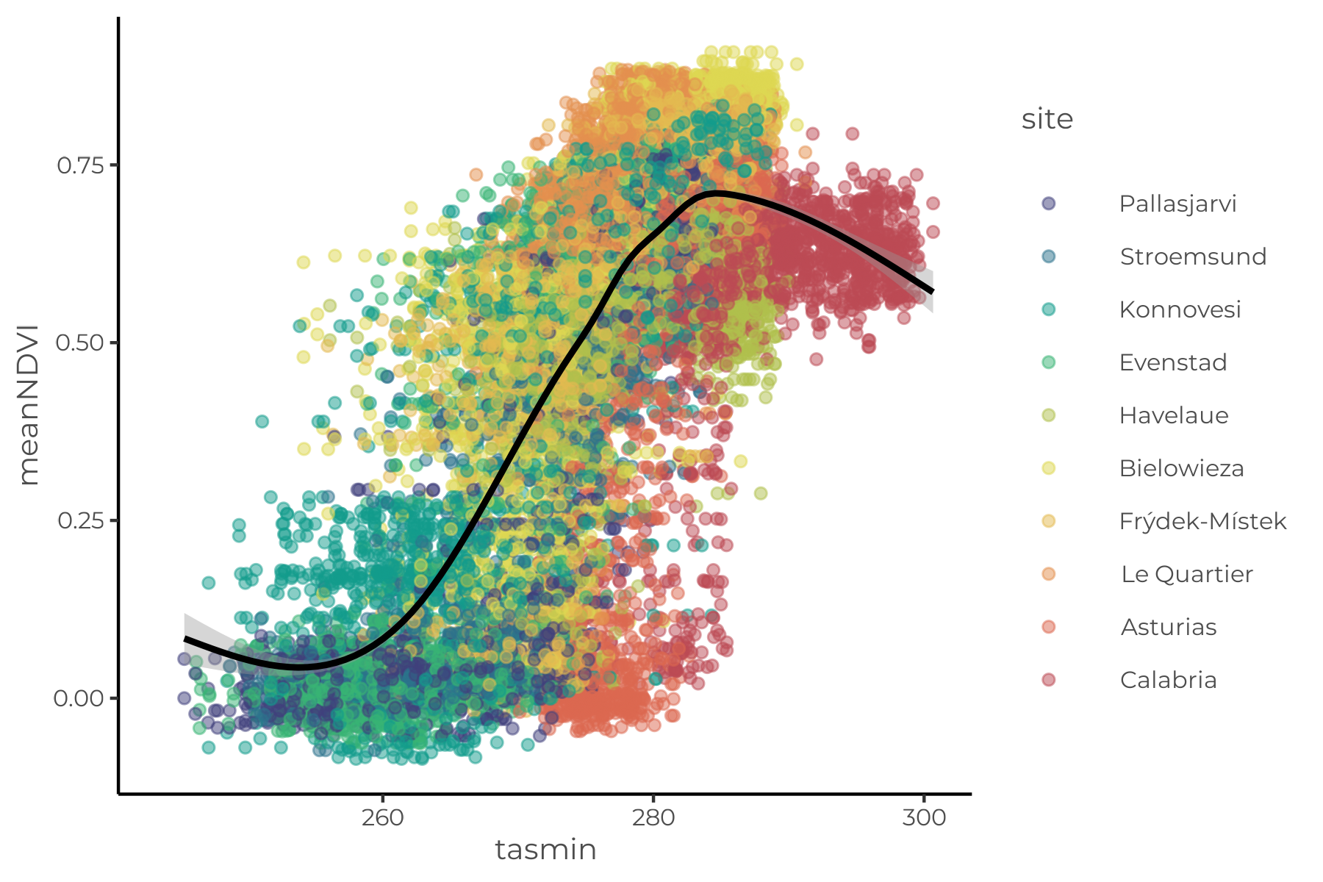
Combining GCM and VI data

Slide 8
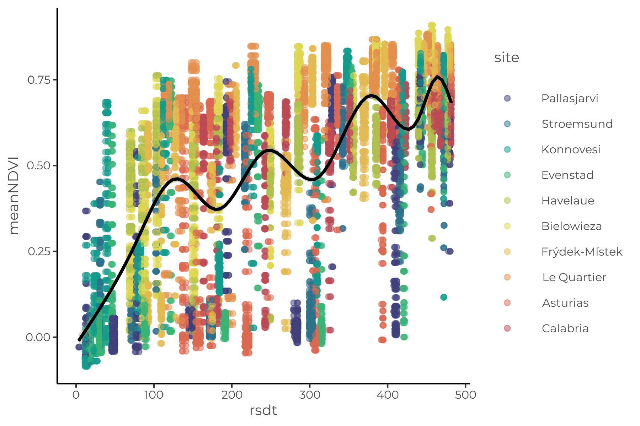
Combining GCM and VI data

Slide 9
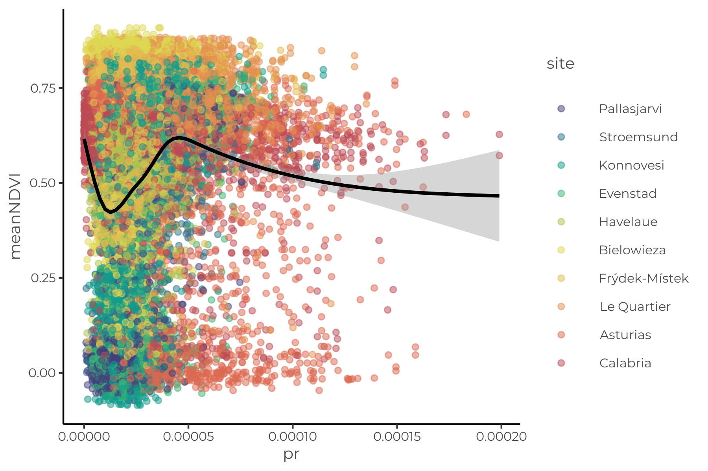
Combining GCM and VI data

Slide 10
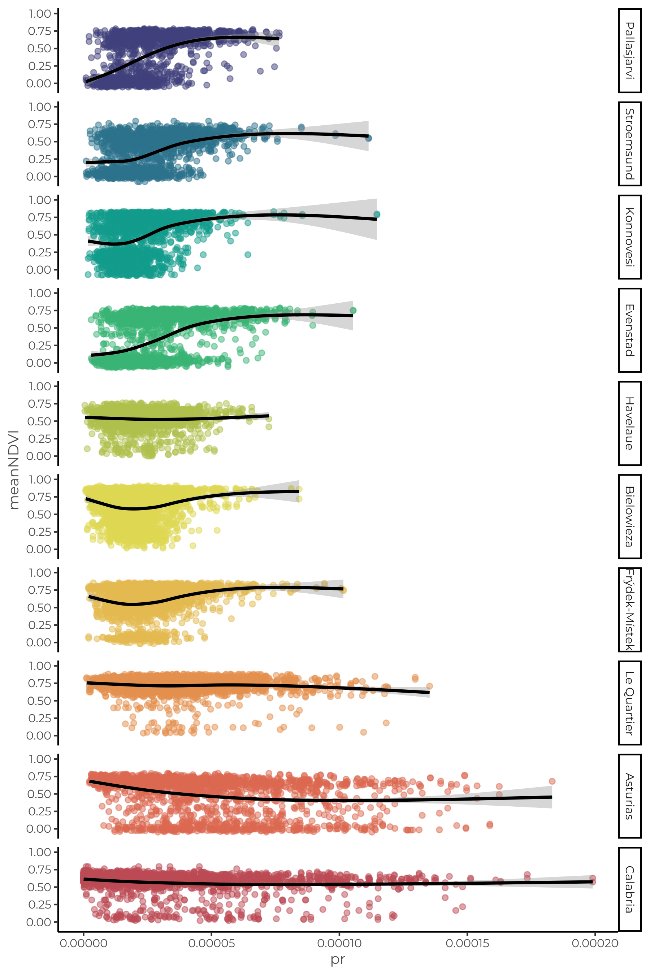

Slide 11
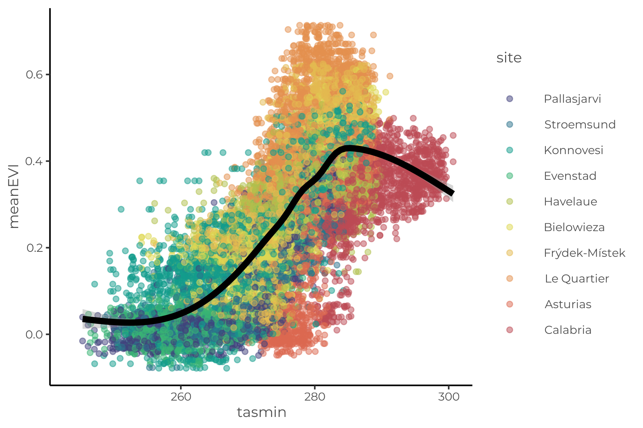
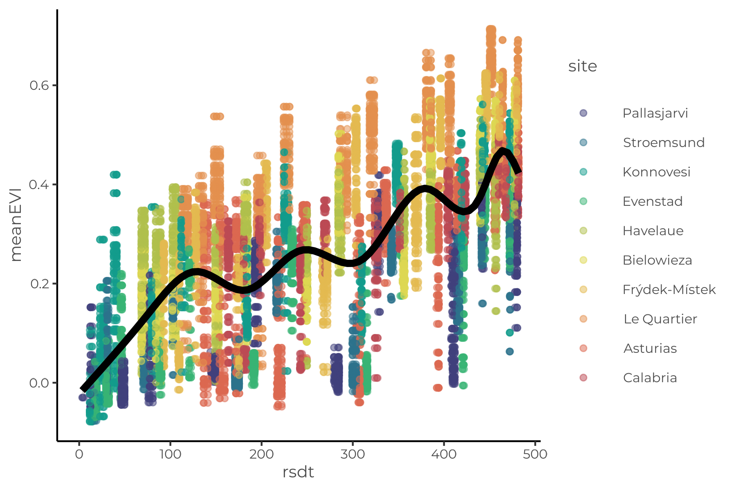
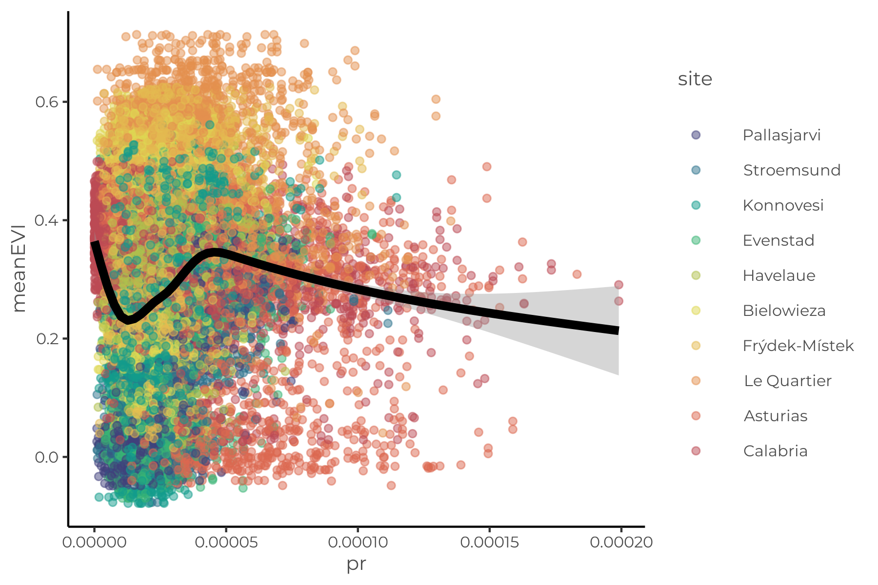
Combining GCM and VI data

Slide 12
Generating projections
Fit linear mixed-effects models
meanNDVI ~ pr + rsdt + tasmin + (1 | site)
meanEVI ~ pr + rsdt + tasmin + (1 | site)

Slide 13
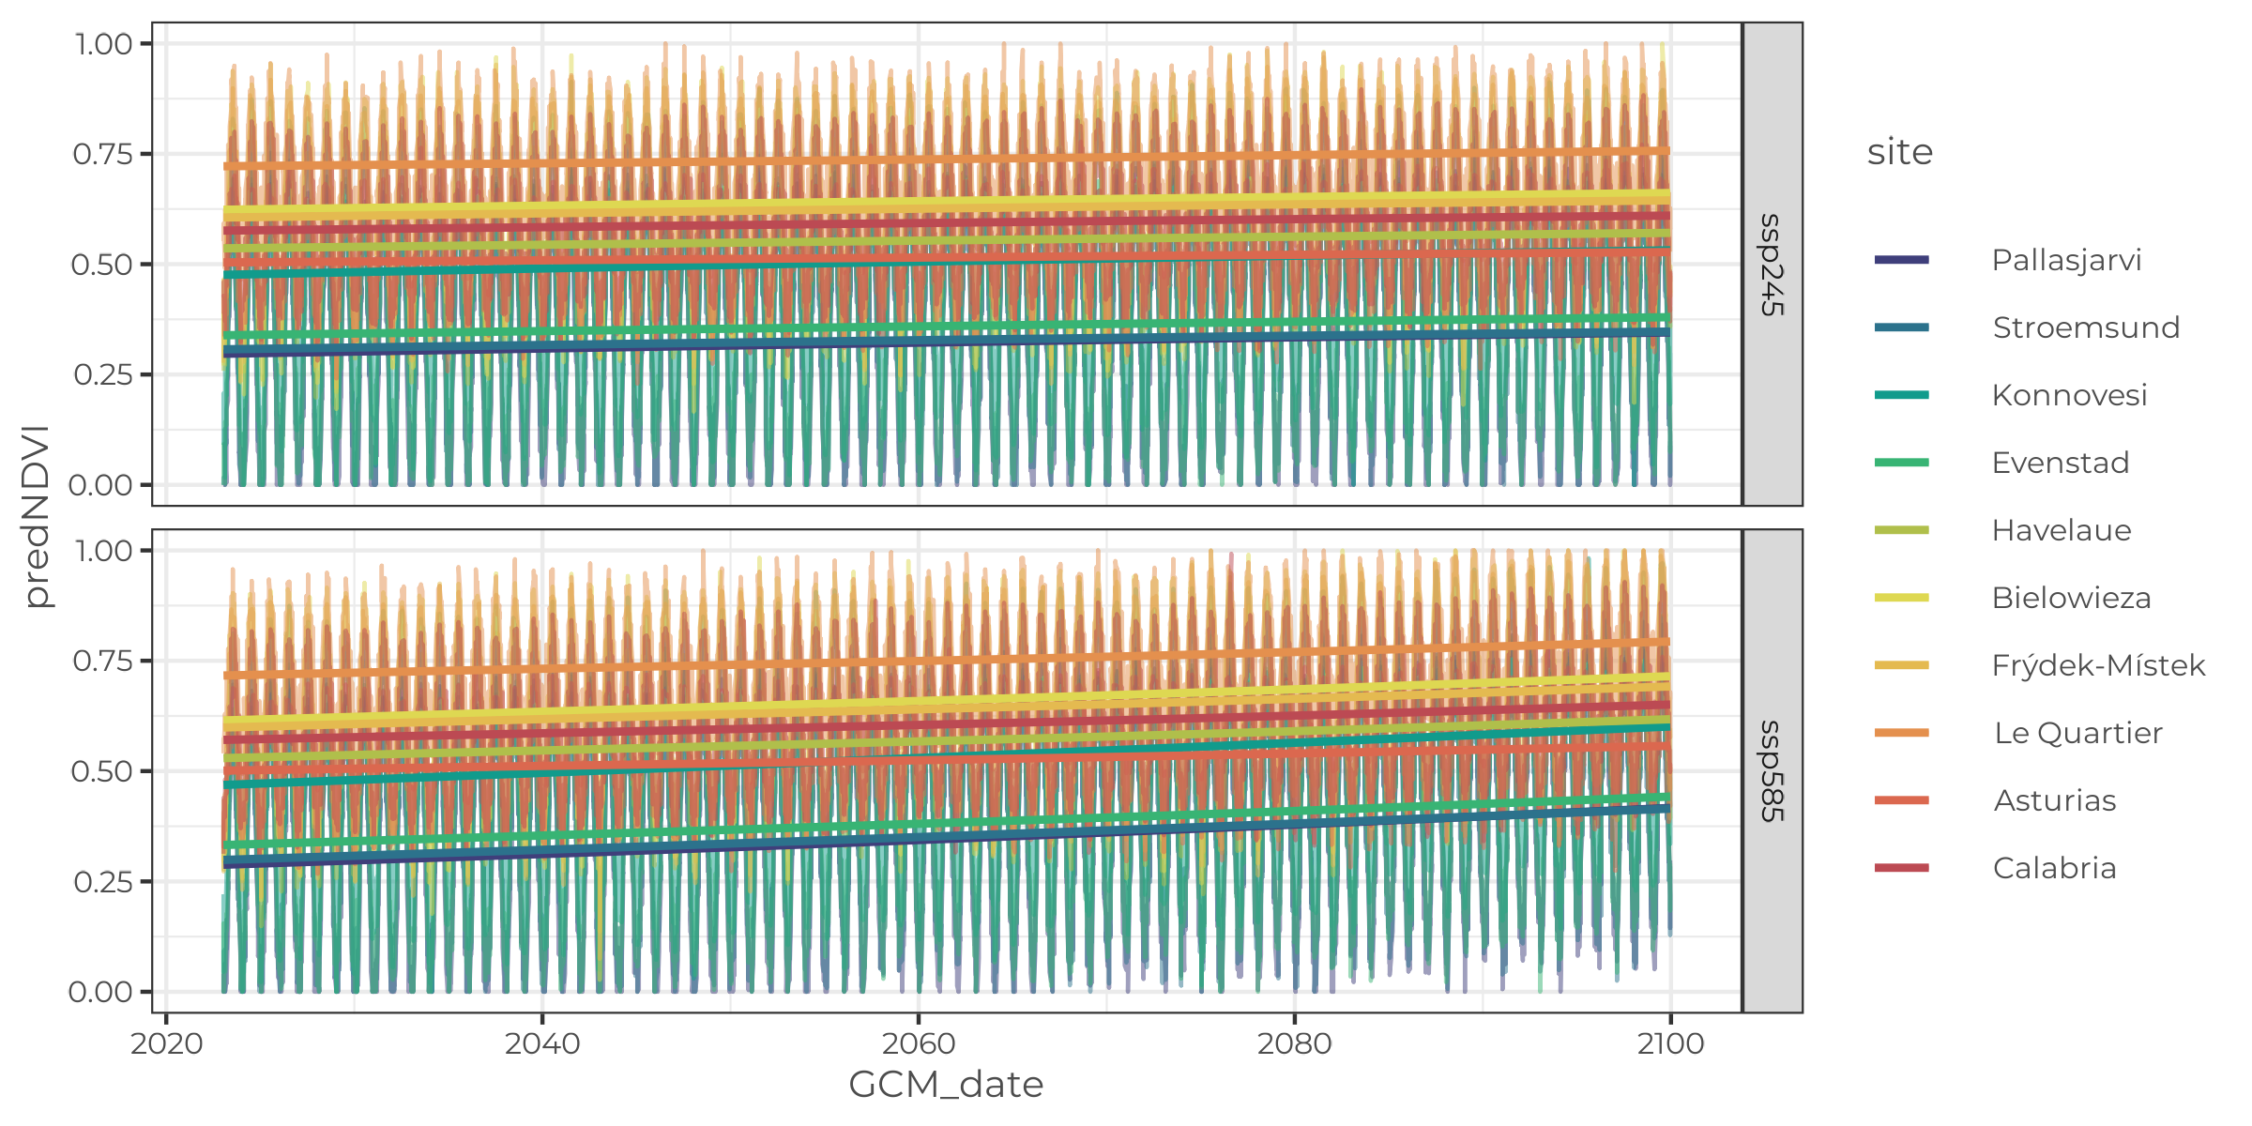
Generating projections

Slide 14
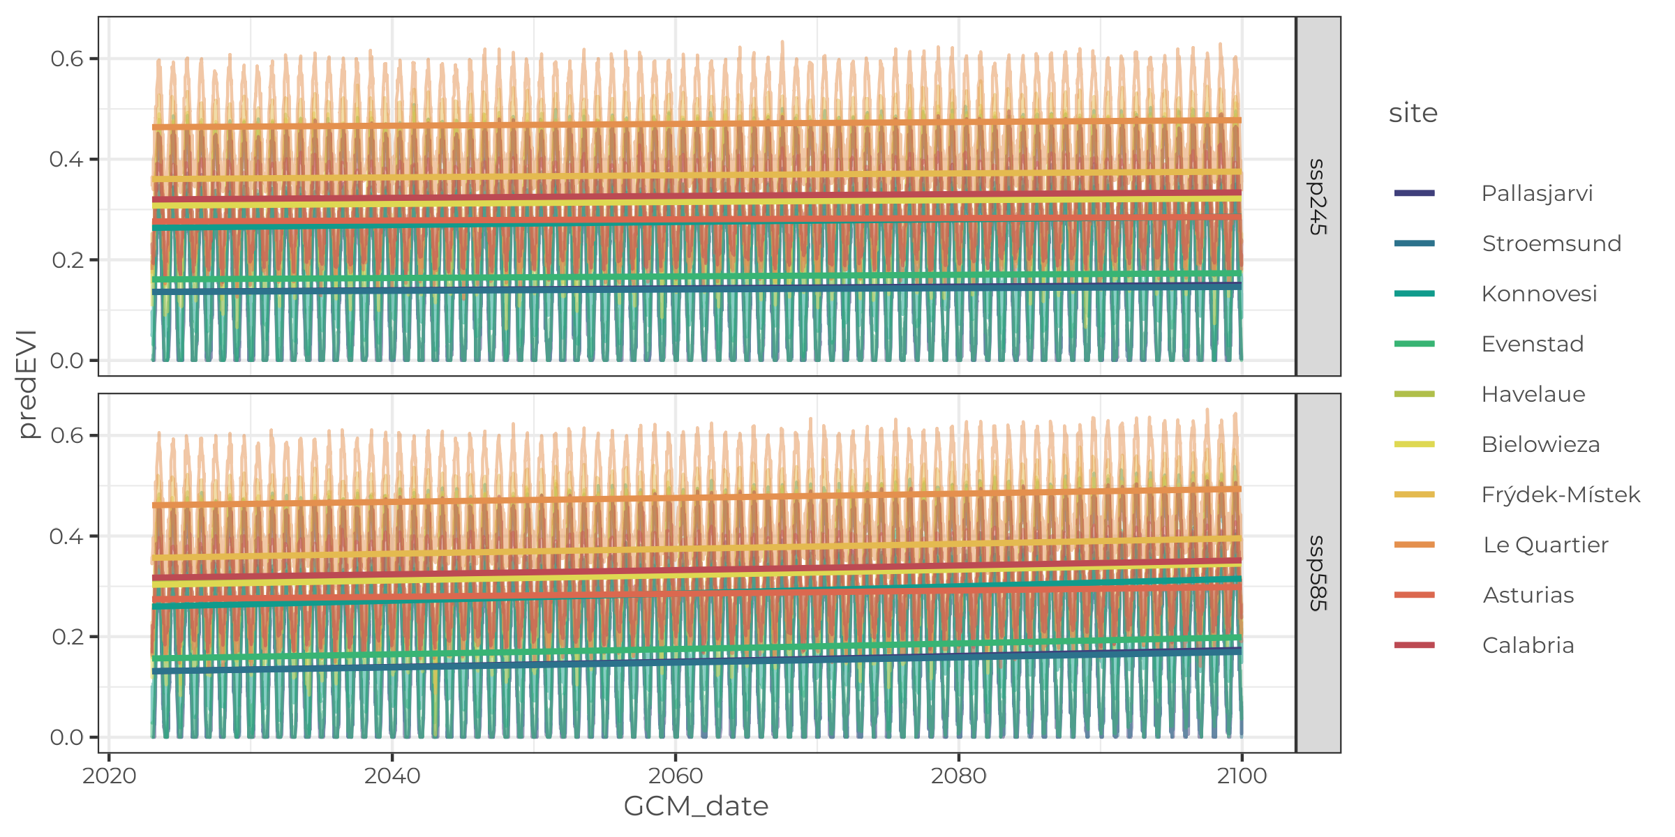
Generating projections

Slide 15
Integrating projections in the ABM
Maximum resources per resource cell
Resource growth rate

Slide 16
EVENET presentation
Modelling the emergence of metabolic trait diversity in rodent populations
The vast array of physiological trait variations within and between rodent species reflects the myriad of evolutionary pressures shaping this group, including those induced by changes in resource dynamics. Here we introduce an agent-based energy budget model designed to explore the eco-evolutionary consequences of alterations in resource environments on terrestrial mammal populations. While generic by design, the model is parameterized and tested against empirical data for bank voles (Myodes glareolus). By applying the model to scenarios of spatially and temporally variable resource dynamics, we investigate effects on the emergence of metabolic trait variations, the context-dependence of energy allocation strategies, and population dynamics. Overall, this modeling approach provides a valuable tool for testing basic and applied research questions related to species energetics, ecology, and evolution in the face of environmental changes, both natural and human-driven.

